Slide 1
Module 5: Leader of the Free World
Talk | Title | Time Period | Date of Talk
30 | Isolationism interrupted | 1939-1941 | January 20th
31 | The European War | 1941-1945 | February 3rd
32 | The Pacific War | 1941-1945 | February 17th
33 | America and the Post War World | 1945-1949 | March 3rd
34 | USA during the 1950’s | 1949-1960 | March 17th
35 | The Cold War | 1948-1960 | March 31st
36 | Camelot | 1961-1963 | April 7th

Slide 2
Talk 32 The Pacific War
Japan in the ascent (December 1941- April 1942)
US Response (1941-1942)
The Turning Point (1942)
…..Intermission
Leapfrogging campaign (1943-1944)
Pacific Endgame (1944-1945)

Slide 3
Pacific versus European War
European War
Pacific War
Future control of Pacific and far East
Naval war for US, land war China
Rules of war ignored (Indiscriminate bombing (US), civilian massacres (Japan)
suicide, prisoner maltreatment
Prevent Fascist domination of Europe
Primarily land war between vast armies
Rules of war in place by US, UK Germany) ( military targets, prisoners taken, gas not used) …ignored Eastern Front & holocaust
War of the tank
War of the Aircraft Carrier

Slide 4
The Ascent of Japan

Slide 5
Japan after Pearl Harbour
US Pacific Fleet neutralised
Battle fleet annihilated
US carrier fleet untouched
Japanese naval and military superiority
Goal: grab as much territory as possible and build fortress before US counter attack

Slide 6
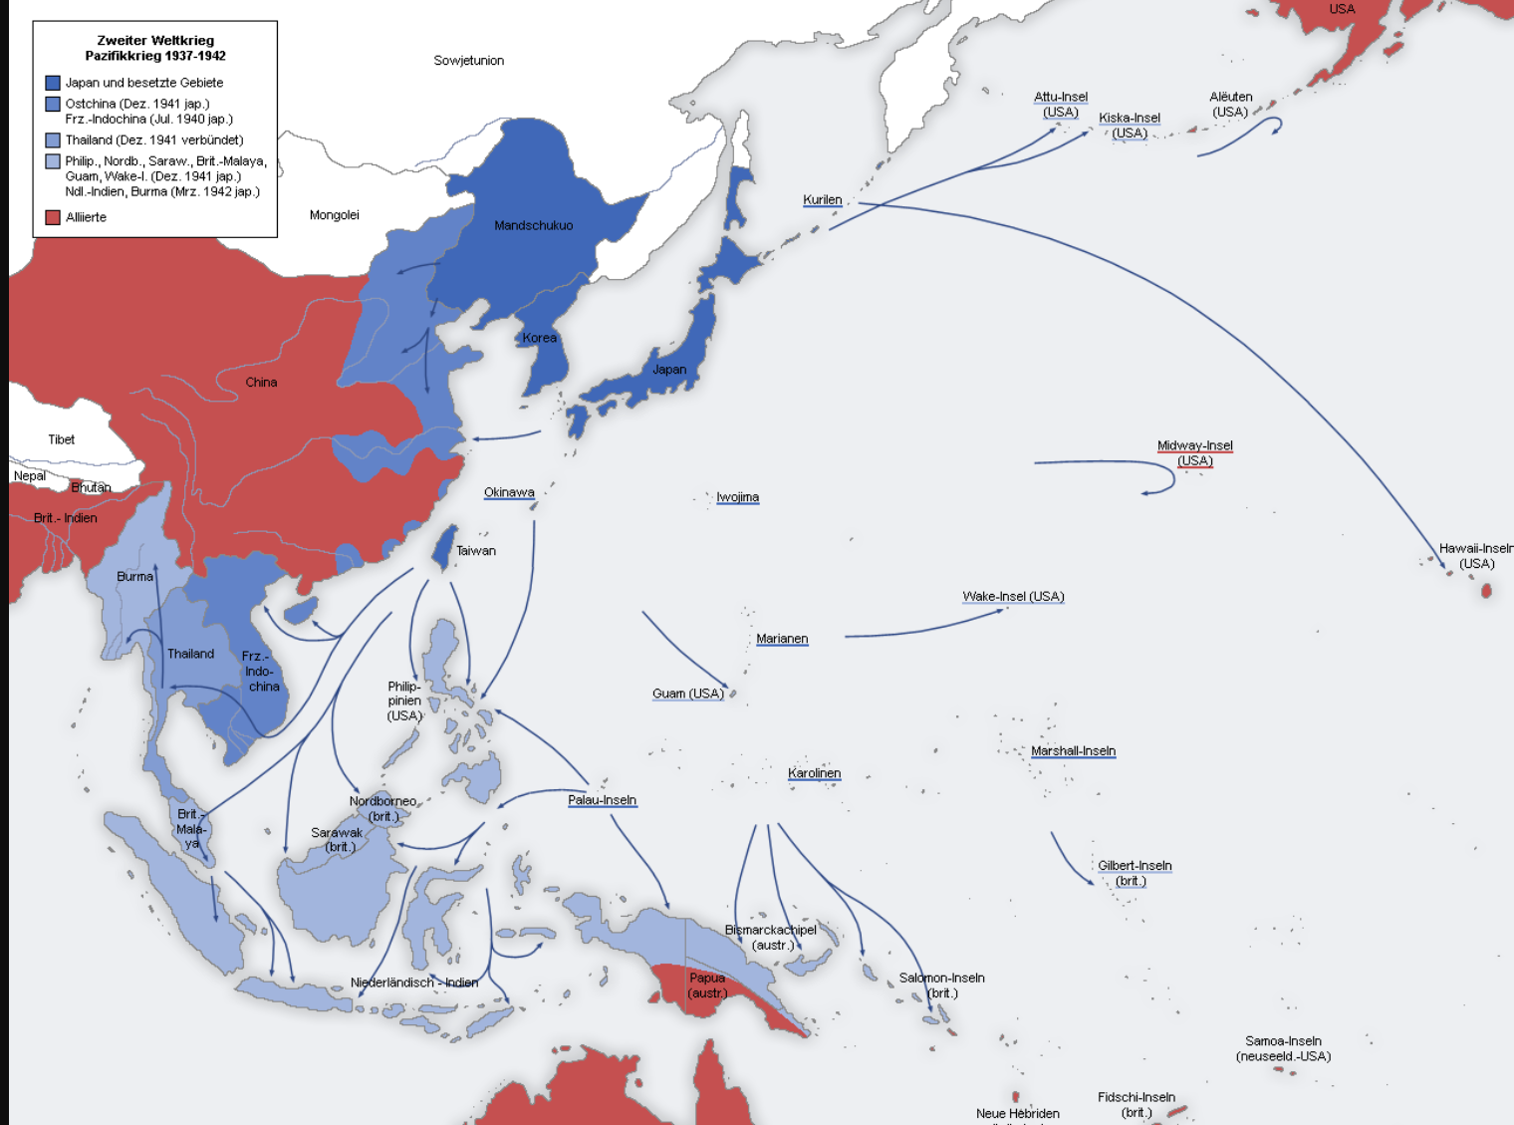
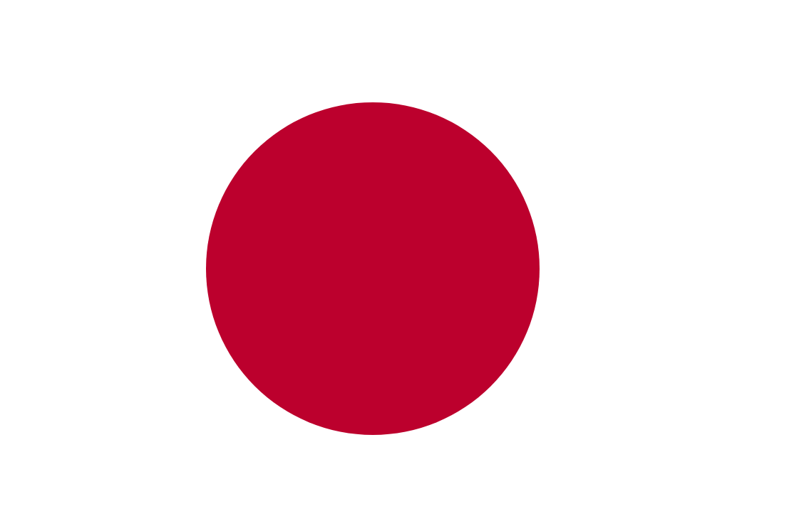
Japanese Conquests December 1941-April 1942
Impasse in China
Japanese army of 1.5m
Control coast, North
KMT & CCP “allied”
1
1
2
2
Seize Hong Kong
US Guam. Wake
Philippines
3
3
Invade Malaya, Burma
Dutch East Indies

Slide 7
Philippines 1941-1942
Spanish colony 1565- 1898, US invades 1898
War of Independence 1899-1902---US “victorious”
Autonomous civilian government 1920’s….US “military advisor”
Independence commitment 1934---10 year transition
Japanese invade December 1941

Slide 8
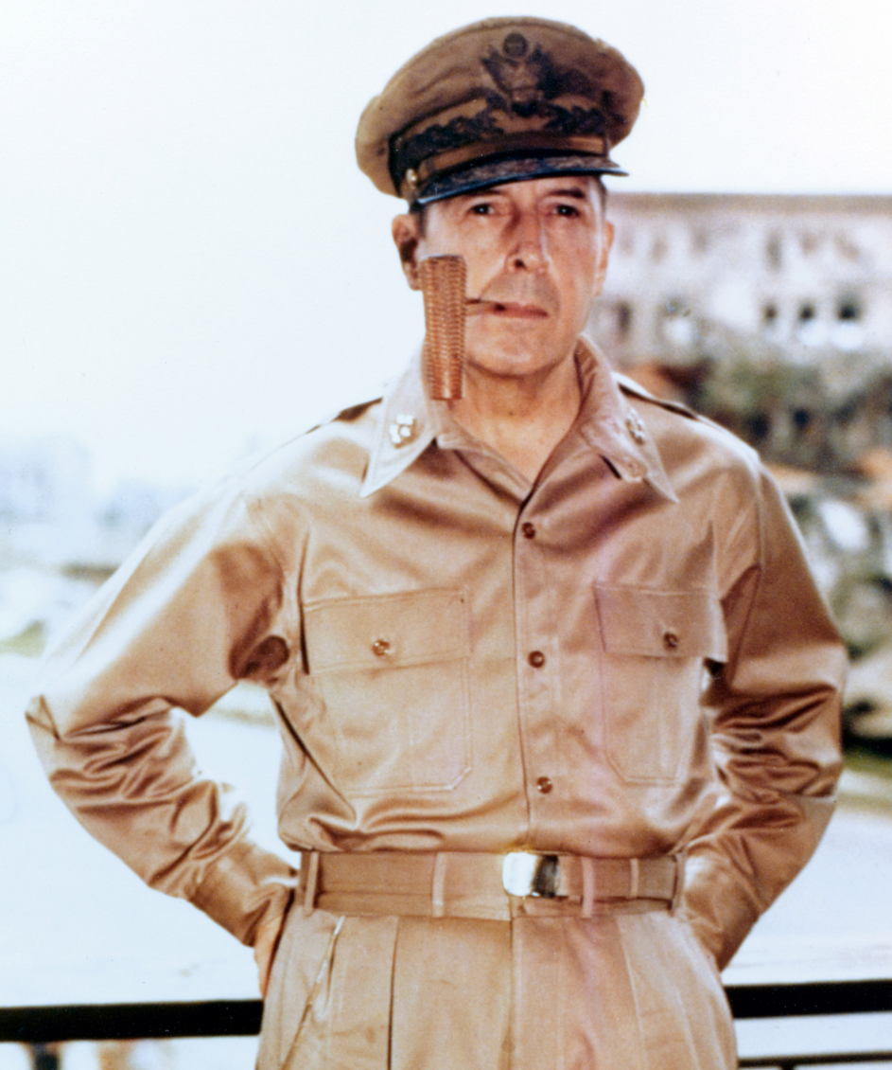
Douglas MacArthur (1880-1964)
Military family
WW1 war hero
..Crush Bonus army
Military Advisor to
Philippine Government
20,000 US Marines
80,000 Philippine army
Sends air force out to
attack…prematurely
..return to refuel
…Japanese attack
& annihilate air force

Slide 9
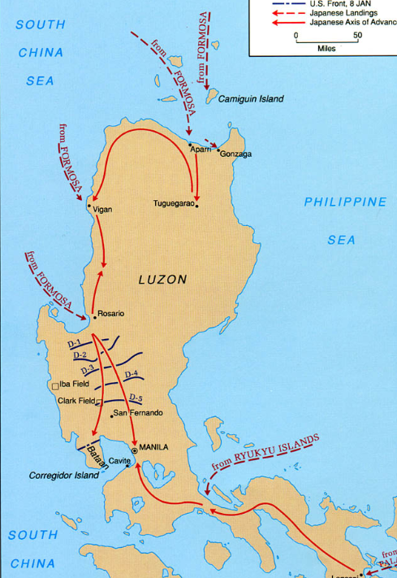
Invasion of Philippines
Japanese surprise
landing
US/Philippine army
Chased to Bataan
peninsular
MacArthur evacuated
To Australia “I shall return”
..US army of 12,000 +70,000
Filipinos surrender
…”Death March” to camps
..30% will die imprisoned

Slide 10
Japan at its zenith
Capture Guam, Wake, US Pacific islands
Indochina army of 70, 000 invades Malaya
British/ Australian/ Indian army of 140,000 untrained, ill equipped, arrogant
Route British Australians in Malaya ,15,000 British, 30,000 Australians, 40,000 Indians captured…”death march”…European population in camps
British army withdraws to Burma, chased to Indian border
Destroy combined Dutch, US and Australian fleet at Battle of Java Sea
Occupy Dutch East Indies March 1942….secure OIL
Japanese victorious everywhere ….and seem invincible …

Slide 11
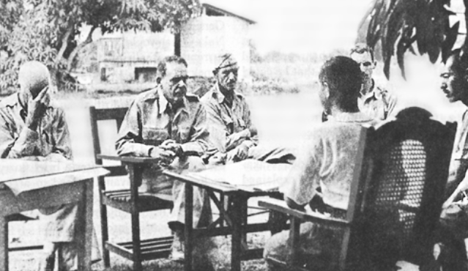
US surrender at Bataan

Slide 12
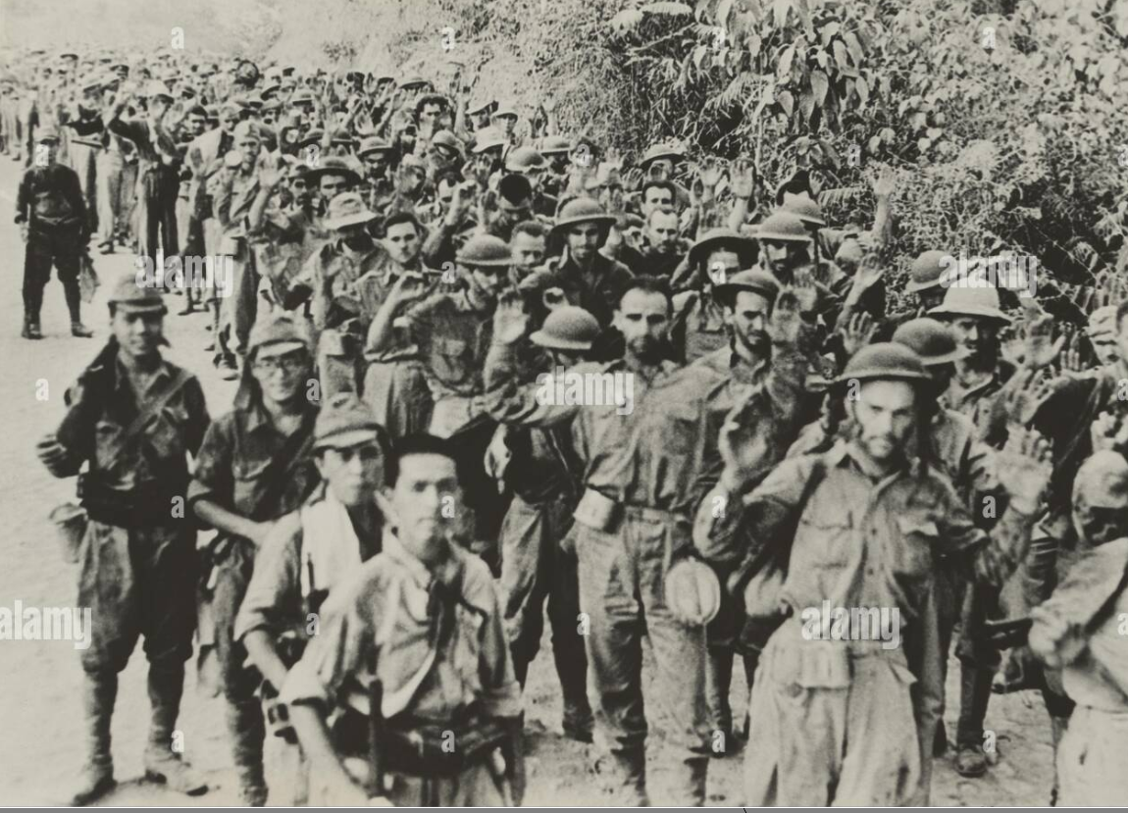
US soldiers on “death march”

Slide 13
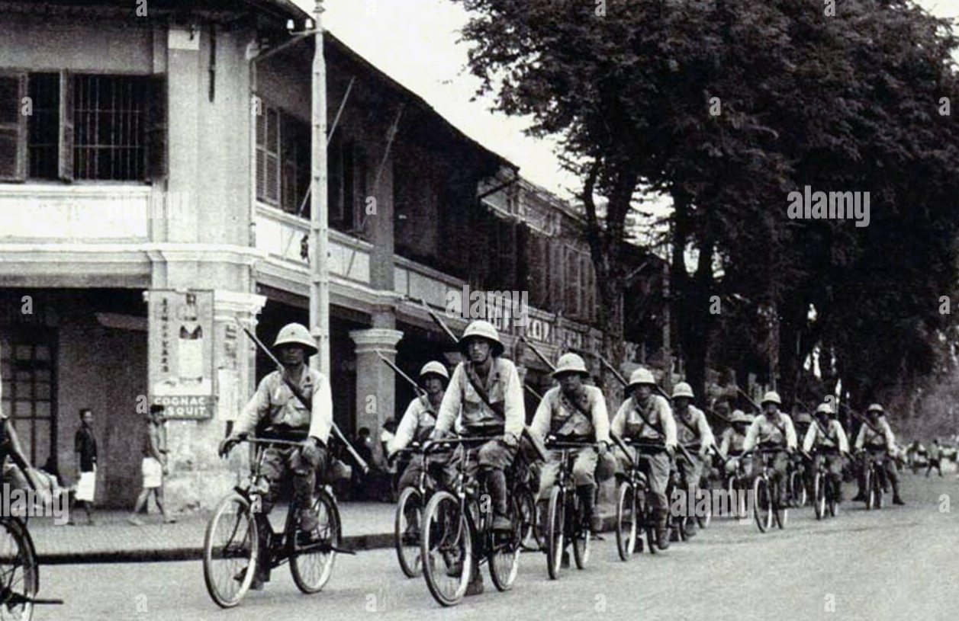
Invasion by bicycle

Slide 14
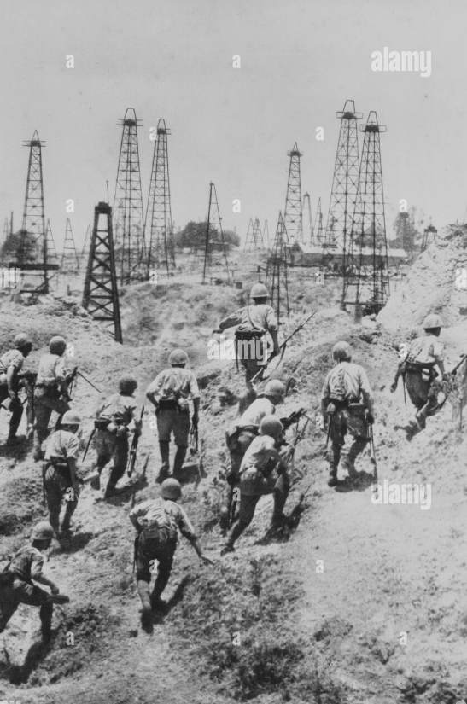
Securing oil fields Burma 1942

Slide 15
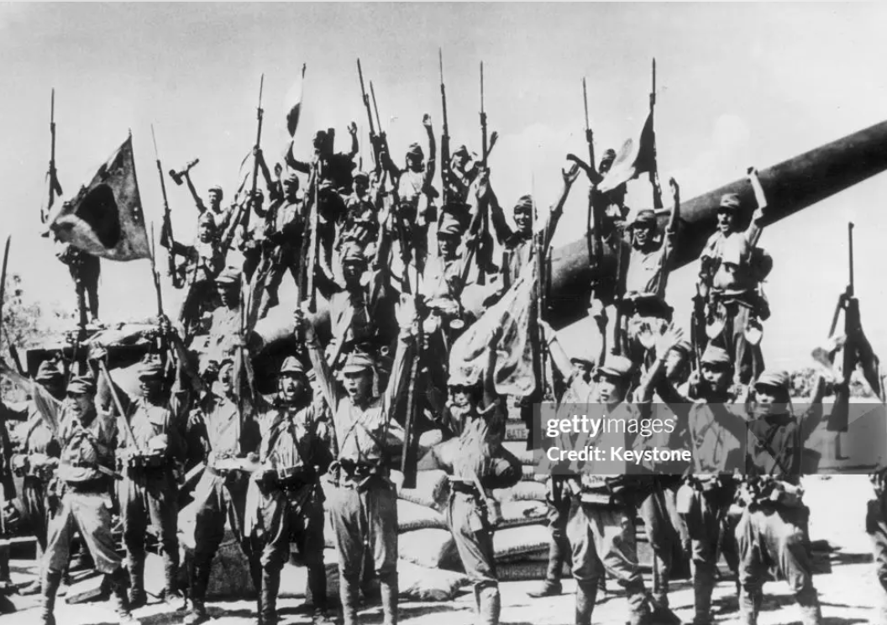
Japan April 1942- victory everywhere

Slide 16
The US Response

Slide 17
War fever across USA
National unity
Decision to priories war with Germany kept secret
Recruitment surges for war vs Japan, draft needed for European war
Build, Build Build….ships, planes,tanks,trucks
Public demand retaliation vs Japan…and Japanese (including those living in USA)

Slide 18
Public enraged by attack and ”Death March”

Slide 19
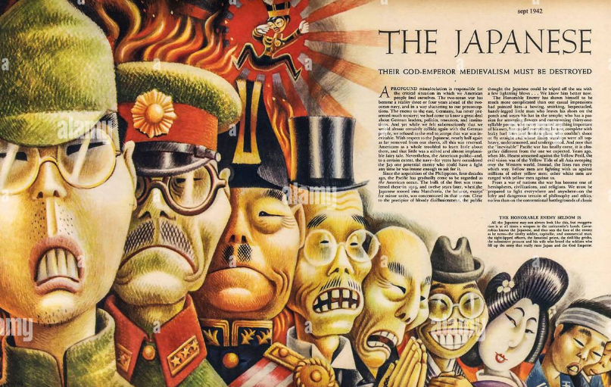
Rage ….becomes racism

Slide 20
Japanese as killers: “others”

Slide 21
Balance of power after Pearl Harbour
The Pacific Fleets January 1942
 | US Pacific Fleet | Imperial Japan
Aircraft Carriers large | 4 | 6
Aircraft carriers small | 0 | 4
Battleships | 3 | 10
Cruisers | 22 | 38
Carrier aircraft | 400 | 600
British fleet removed to Indian Ocean, Dutch fleet sunk

Slide 22
Balance will shift to US…..and soon
Warships under construction…available 1943
 | USA | Japan
Aircraft carriers (large) | 12 | 3
Air craft carriers (small) | 20 | 2
Battleships | 6 (plus 4 being salvaged) | 3
Pilots as important as ships: US adopt industrialised approach: 12,000 “carrier qualified trained pilots end 1942, Japan 1,500
Japan has less than one year to gain overwhelming victory

Slide 23
Japanese in USA 1941
Japanese in the USA
Immigration from 1868…sugar plantations Hawaii,
California 1882 after Chinese Exclusion Act 1882….replacement Chinese
20,000 immigrants to USA by 1900….perils of success: threat to white farmers
Gentleman’s Agreement 1907: skilled, students, spouses only
1924 Immigration Quota …immigration reduced to 2,000 per year
250,000 Japanese Americans at time of Pearl Harbour
90% US citizens, most 3rd generation…lack of immigration
Mostly middle income/ business owners
Mostly on west coast
100,000 in mainland…90% California
150,000 Hawaii…33% population

Slide 24
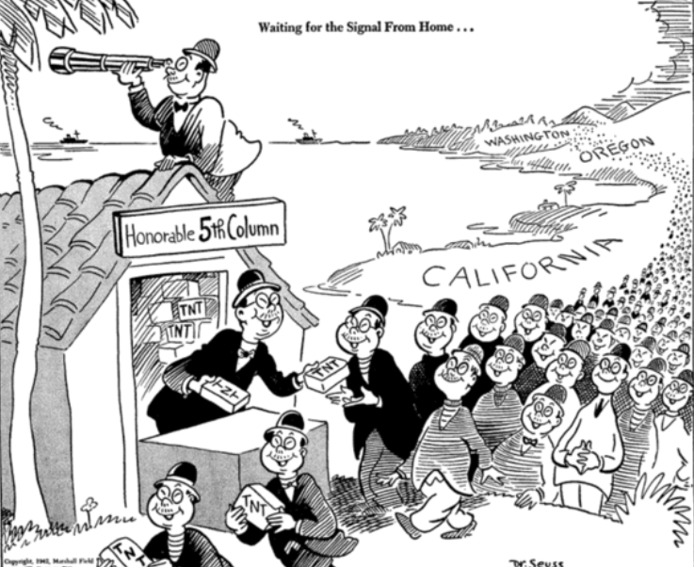
Fear of 5th column….New York Times

Slide 25
Executive Order 9066 February 1942
Blanket order to locate all mainland Japanese to Internment camps
Families relocated to “instant cities” desert/ wilderness
Abandon businesses/ Allowed to take what could be carried
Hawaii exempted since 33% of population
No evidence of collusion with Japan among mainland Japanese Americans
Life at camps
Armed guards but life Industrious, educational,
30% “Nisei” allowed to join military 1943
Compensation at end of war (10% of losses) , $20,000 payment 1980

Slide 26
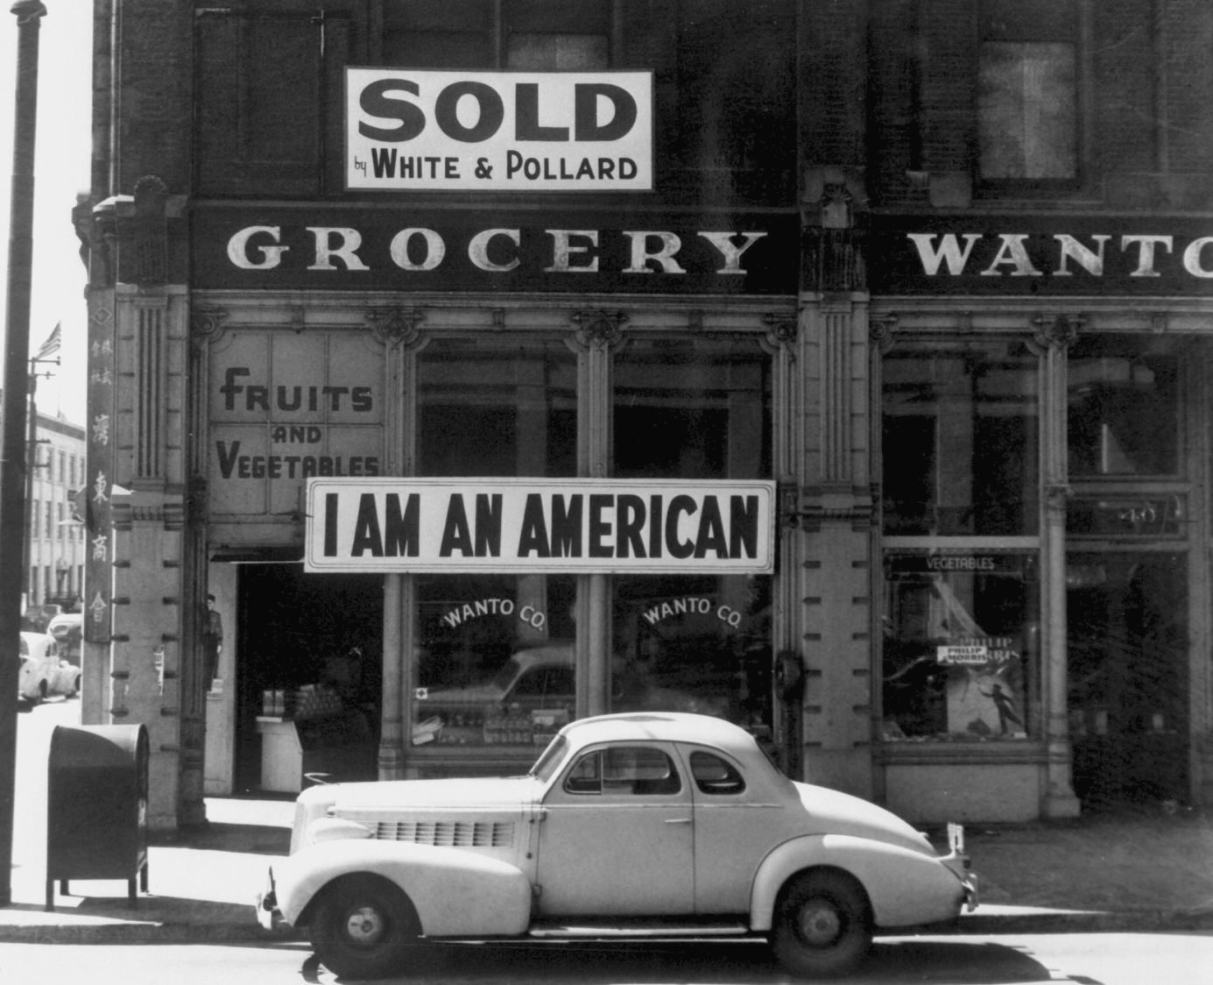
No resistance, indignation, shock

Slide 27
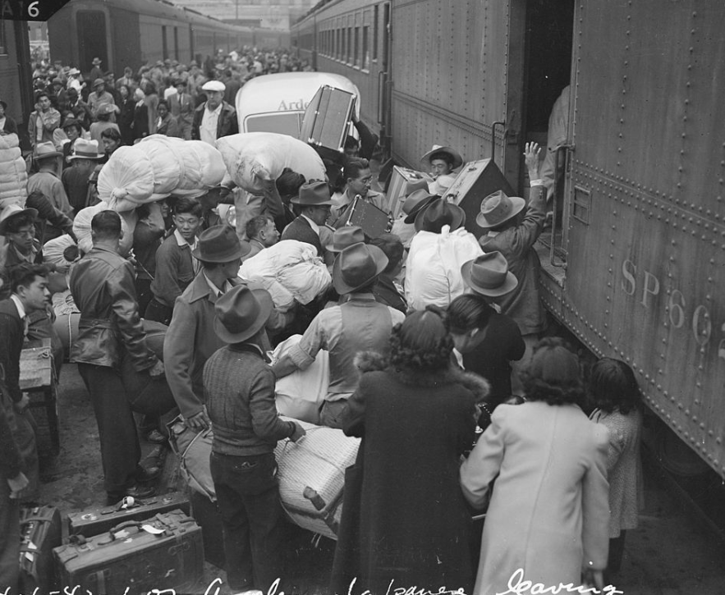
Carry what you can

Slide 28
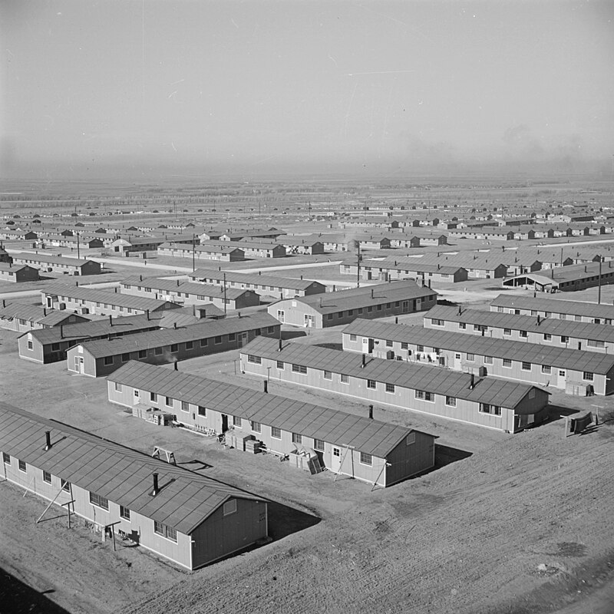
Dispersed in 10 “instant cities”…till 1945 schools ….normal life, but cannot leave

Slide 29
The need to do something….NOW
US public outrage must be fed to keep war momentum
FDR/ Administration dilemma:
Prioritise war with Germany
Fleet devastated at Pearl Harbour
Carriers intact….but vulnerable, light aircraft
Solution: symbolic morale boosting bombing raid on Tokyo
…adapting bombers to take off from aircraft carriers
…bomb Tokyo, land in KMT controlled China

Slide 30
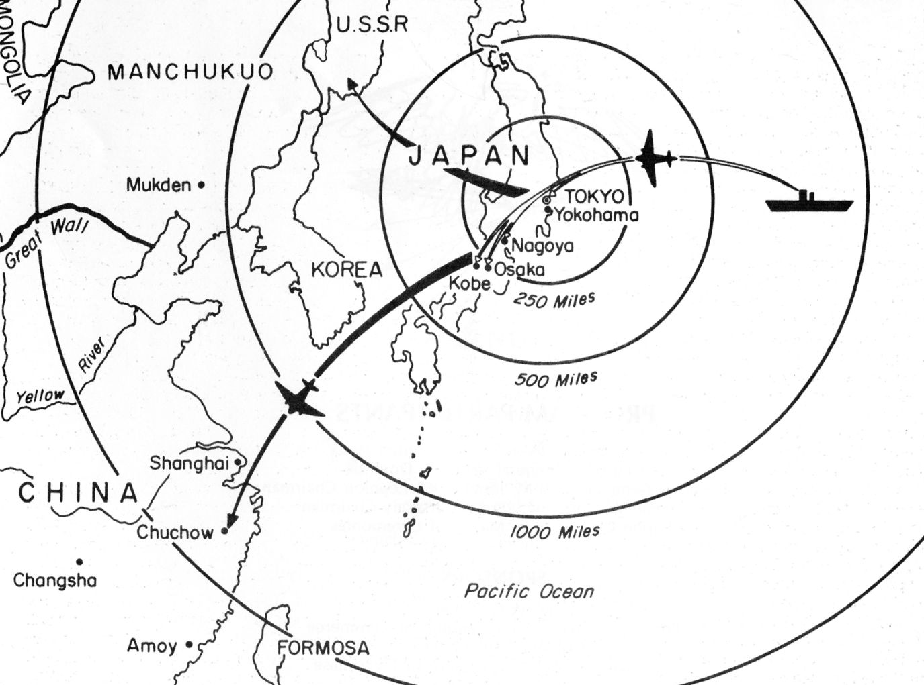
Doolittle Raid April 1942
17 bombers on 2 carriers
One way mission…cannot
Land….plan to fly on to
Chinese controlled aircraft
Volunteer crews led by
American hero (former
Stunt pilot, pioneer
James Doolittle

Slide 31
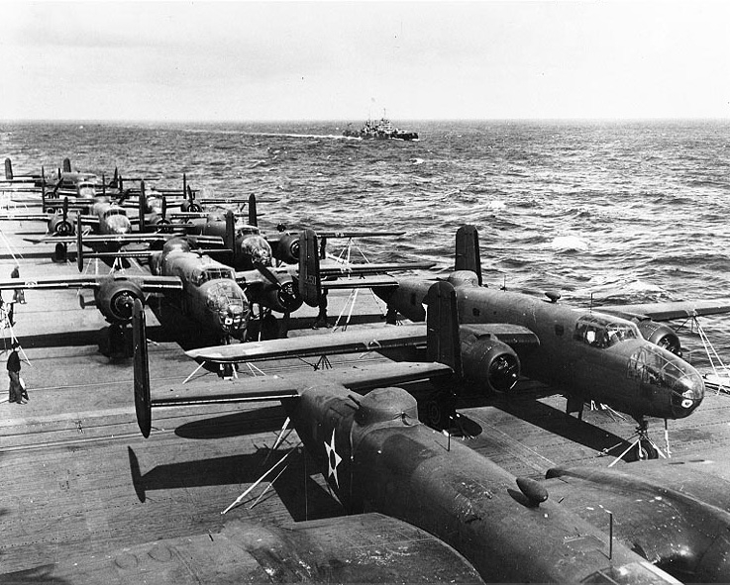
Mitchell bombers stacked on USS Hornet …..bound for Japan

Slide 32
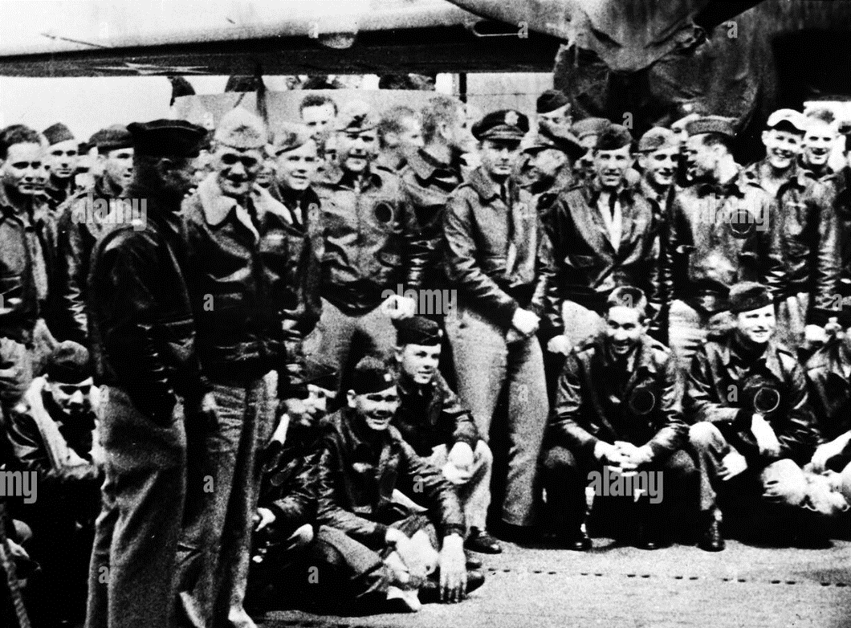
………..The briefing

Slide 33
The Raid and its impact
The Raid
Carrier fleet detected by Japanese warship 100 miles from take off point
US sinks warship…does not know if it has signalled (it did not).. decide to go ahead with raid
Minimal damage, 50 civilians killed, Crew bail out China, 4 killed, 8 captured (4 recaptured by Chinese)
Outcome
USA euphoric
Japanese in shock
Execute 3 captured pilots
Undertake terror campaign in area of China where pilots rescued
Biological weapons unit spread pathogens, anthrax in area….estimated 250,000 civilian deaths

Slide 34
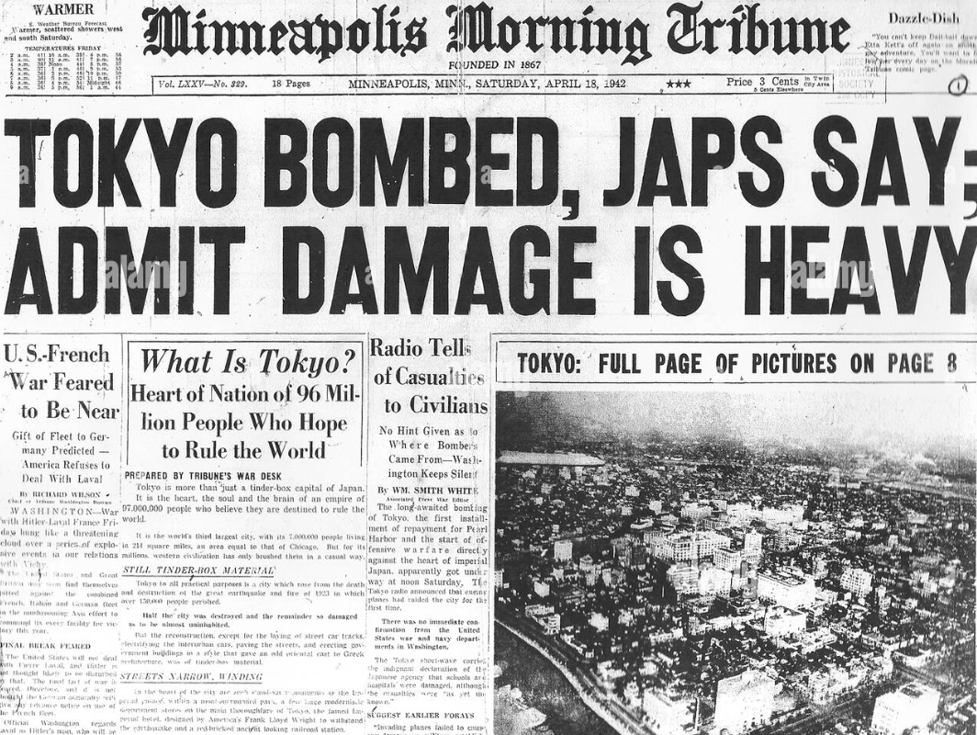

Slide 35
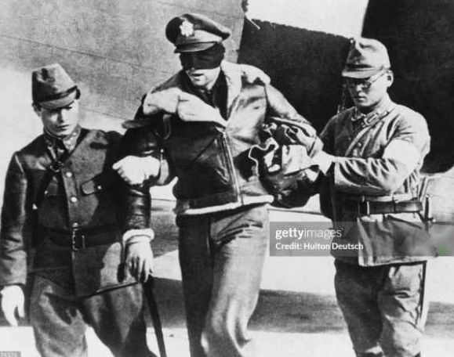
Captured pilot…to be executed

Slide 36
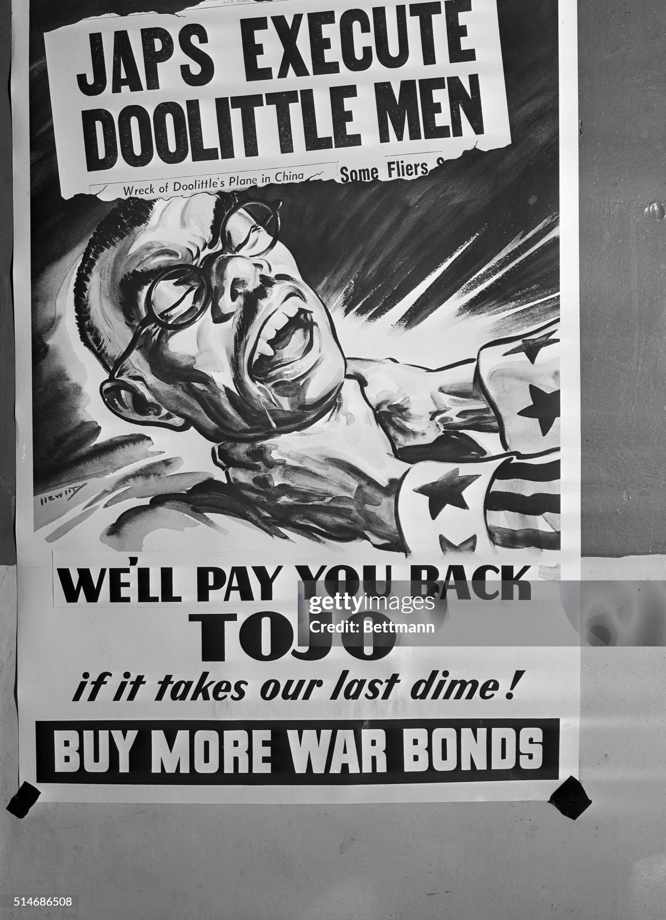
Escalation breed escalation….defines tone and shape of Pacific War

Slide 37
Major outcome: Japanese resolve to seek out and destroy rest of US fleet …capture island of Midway as air base

